Slide 1
Re-thinking Evaluator Competencies in an Age of Discontinuity
One Minnesotan’s View

Slide 2
Obvious implications of the pandemic for rethinking evaluator competencies
When people are at risk of dying, evaluation may well seem (or even be?) less important
Traditional ways of conducting evaluation simply can’t work the same way

Slide 3
Grounding for my comments
My ardent belief:
EVERYONE
IS AN EVALUATOR
My job is to build on what exists in any setting and help to “systematize” it

Slide 4
“Free range evaluation”
It has been my commitment for well over 25 years to build people’s capacity to DO and USE evaluations
BUT very few funders in my context want to pay for capacity building
They more typically support accountability and Western “science”

Slide 5
Implications for “training” evaluators
Enter settings with humility and an openness (eagerness) to learning
Be willing to NOT be the expert
Foster, support, and believe in evaluation capacity building
Build on the “knowledge systems” people have in place

Slide 6
My suggestions about how to work in communities
Make sure you have the support of positional leaders (or at least not opposition)
Identify/support/collaborate with evaluation advocates in situ (do not call them evaluation champions)
Develop/teach/learn from evaluation liaisons: community members who learn enough about evaluation to engage others, advocate, and support the process

Slide 7
A key requirement: Commitment over the long haul
This is not how most con-tracts are written
You must be able to respond to evolving contexts/crises
It suggests why teaching community members may be a cost-effective way to proceed

Slide 8
Rapid Response to on Multiple Ideas
This is definitely free range. . .

Slide 9
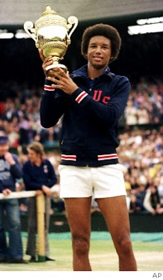
“Start where you are.
Use what you have.
Do what you can.”
- Arthur Ashe

