Slide 1
Evaluation Machines and Evaluator’s Resilience:
topics for evaluation training
programs
Frans L Leeuw
Maastricht University

Slide 2
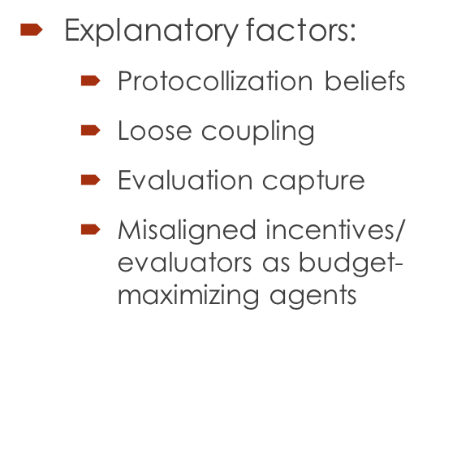
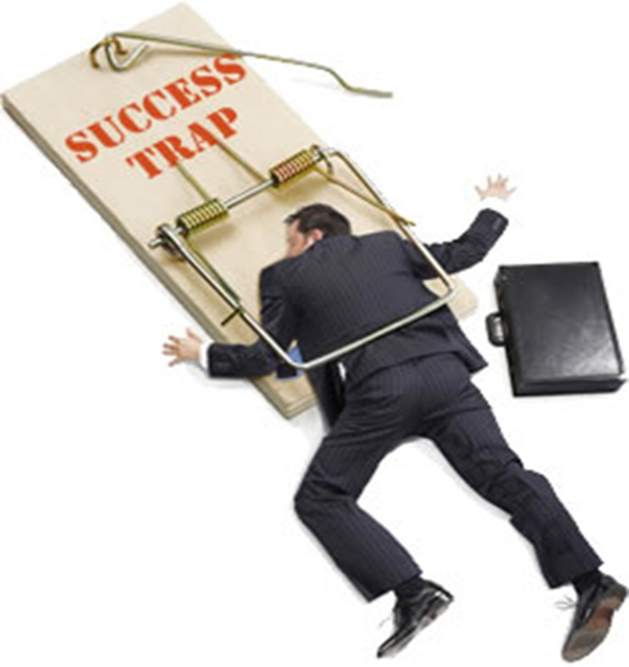
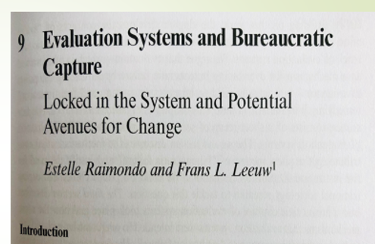
TOPIC 1
1 evaluation as a standing operating procedure, evaluation machines, evaluiitis; and performance paradoxes;
Examples of success breeding its own failures

Slide 3
Incorporating these insights into evaluation training programs
Learning to scan when these trends take place
Discuss and assess these trends and factors
Think about how to ‘fight’ them
Be resilient

Slide 4
TOPIC 2
Resilience is not only a cognitive-intellectual ‘thing’, but an in depth ethical-behavioral approach /style of evaluators of strength in the face of organizational difficulties, stress, (soft) power plays etc., to fight and bounce back which helps the profession to realize goals such as:
Collaborate with stakeholders / commissioners while also fundamentally challenge and criticize them;
Being able to navigate between the demands of evaluation clients and the needs of a valid and credible scientific perspective in the evaluation;
Knowing how to deal with fake-news, cancel culture and fake handbags ( like “selling” Logframes for ToC’s).

Slide 5
Examples of an insufficient or limited evaluator’s resilience
Doing thousands and thousands of implementation (failure) studies finding over and over similar blunders, flaws and fiasco’s but continue doing them because this is requested and paid for;
Claiming to work and test theories of change/ program theories while in fact believing them and search for verifications;
Accepting a stream of “Say-do-behaviors” by Parliaments, governments, agencies, NGO’s etc

Slide 6
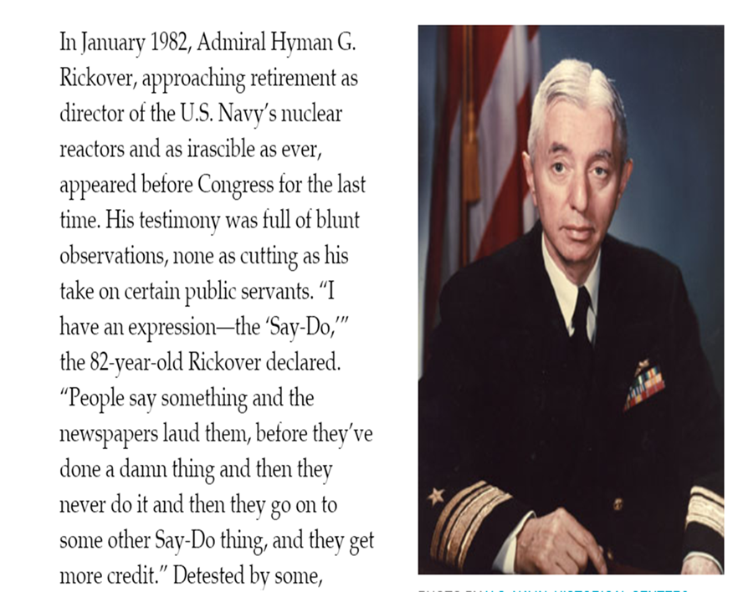

Slide 7
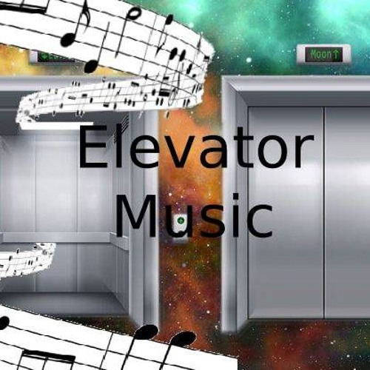
In these kind of situations, a resilient evaluator is a person who has the willpower to loud and clear criticize that type of behavior, understands its causes and may suggest alternative ways to move forward, but with the possible consequence that he or she will be become a Persona non Grata. But, if we do not train our evaluators how to deal with these challenges, we may end up producing Harmless WallPaper and/or Elevator Music.

Slide 8
Some references
Lyn Pleger & Frans L Leeuw, Resilient Evaluators: Characteristics, conditions and prospects, in: Rob van den Berg et al (eds), Ethics for Evaluation. Beyond “doing no harm” to “tackling bad” and “doing good”. Routledge, in press: chapter 7.
Estelle Raimondo & Frans L. Leeuw, Evaluation Systems And Bureaucratic Capture: Locked In The System And Potential Avenues For Change, in: Burt Perrin & Tony Tony Tyrrell (eds), Bureaucracy and Evaluation, Routledge, 2020, p.143-160.
P.Dahler-Larson, The skeptical turn in evaluation, in: J.E.Furubo & N. Stame (eds), The Evaluation Enterprise, Routledge, 2018, p. 58-80.
Sandra van Thiel & Frans L. Leeuw, The Performance Paradox in the Public Sector, in: Public Performance & Management Review, 25, 3 (2002), p. 267-281,
Frans L Leeuw and JE Furubo, Evaluation Systems: What Are They and Why Study Them, in: Evaluation, 14 (2) (2008), p.157–169

