Slide 1
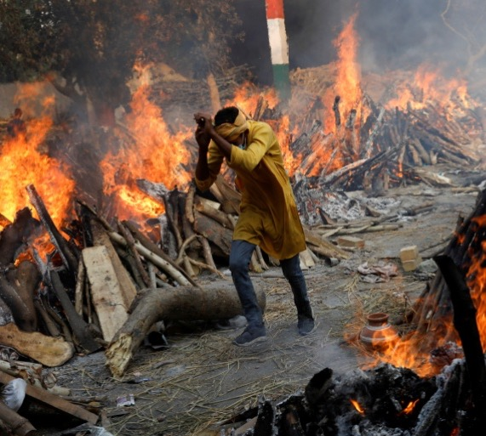
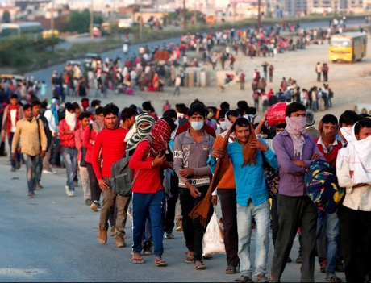
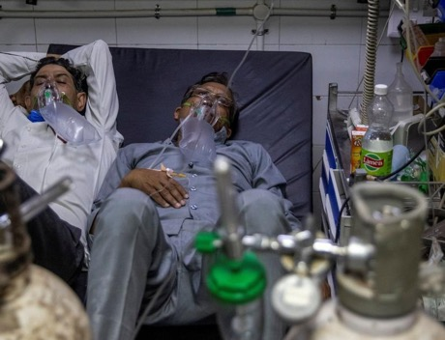
An Evaluator’s Journey and Response
Responding to inequities, vulnerabilities and answering sustainability during COVID

Slide 2
COVID IMPACT

Slide 3
COVID Impact
First Wave: 22-25 million domestic migrants left India’s cities in March and April, returning to families. With transport suspended, many of these journeys were made on foot, with little support
01
Second Wave: Devastating Impact on Lives, Livelihood and Mental wellbeing
02
As the worst of the health impacts of the second wave recede, the lingering questions of livelihoods of vulnerable communities remains
03

Slide 4
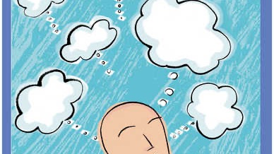
How do I evaluate? Do I have the competency to evaluate in such an environment ?
Data collation or inference
Objectivity or Empathy
My context & vulnerabilities part of overall vulnerabilities
Technical or Relational

Slide 5
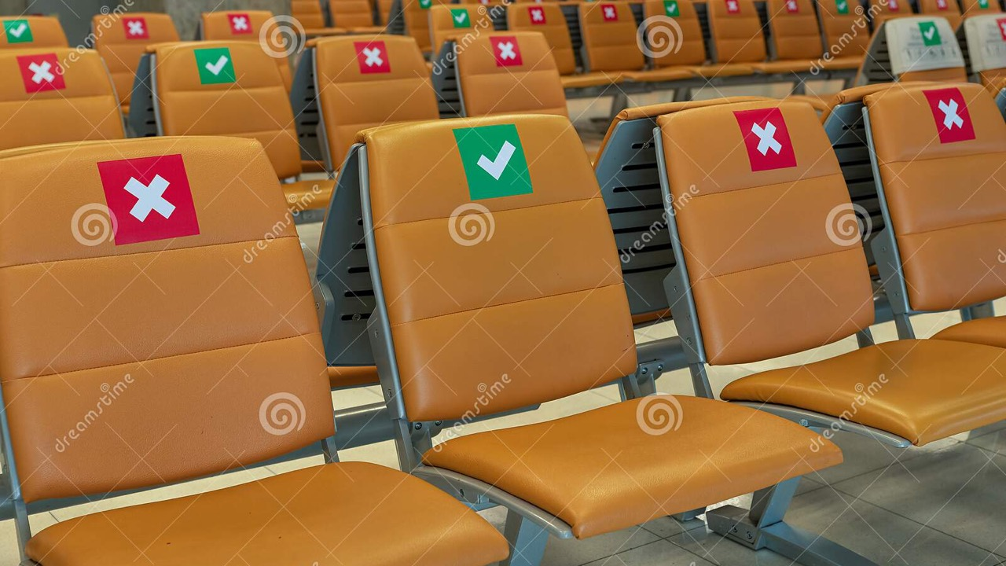
Technical, Scientific Rigor, Objectivity etc.
What set of competencies are more relevant?
Relational
Empathy
Multiplicity of Methodology and Data
Collaborative
Disruptive tech

Slide 6
Empathy

Slide 7
Empathy : How do you approach
Appreciative of the role
Respecting space and time
Building perspective
Showing warmth
Listening

Slide 8
Disruptive in Disruptive world

Slide 9
Using Tech as an enabler
Technology to the fore : Using tech for reaching out to communities
Responsive to their time: Connecting again at a suitable time
Connecting with Team : Brainstorming virtually
Create a collaborative workspace

Slide 10
Methodology and Data Multiplicity

Slide 11
Methodology and Data Multiplicity
Multiplicity of Methodology : A critical factor
Multiple Data points adds value
Helps in moving from problem space to solution space

Slide 12
Relational

Slide 13
Relational
Helps in having everyone on board : Convincing that evaluation add values even in these times
Helps in convincing that evaluation is not about judging but helping them to do better
Better utilization of the findings

Slide 15
Creating a collaborative workspace
Helps in pooling resource in resource constrained environment
Larger access to data
Helps in building multiple Perspective

Slide 16
Thanks & Acknowledgment :
All colleagues, fellow evaluators and most importantly health providers and community members

