Slide 1
RETHINKING EVALUATOR COMPETENCIES IN AN AGE OF DISCONTINUITY. The ‘Other’ Competencies for Effective Practice & Pandemic Response
ROGERS MUTIE
: Rogers Mutie Email: rmutie@iom.int
: @MutieRogers

Slide 2
INSIDE THE MIND OF AN EVALUATION PRACTICTIONER
In theory: independent; pulled off the shelf when needed; some more important than others; can be an evaluation star with just one or few
In actual practice: it is a mosaic; all are needed nearly every moment; are mutually reinforcing; the more you posses & apply, greater evaluation excellence
C6
C4
C1
C2
C5
C3

Slide 3
Evaluator Training: Business as usual?
Impact of Pandemics, crises and the rapidly changing context to evaluation practice:
Disruption to normal processes
Uncertainty about the future
Discontinuity of core evaluation services
Inequalities unearthed or exacerbated
Redundancy as some service become unneeded
…
The Implication
Evaluation practice demands more than the conventional set of competencies.
Competencies previously considered peripheral to evaluation suddenly become CORE.
Evaluator Training(ET) must respond to the need for ‘additional’ skills
ET must build BROAD BASED CAPABILITIES to enable evaluators’:
a) Resilience (navigate all evaluation journey moments)
b) Excellence (perfect the art & craft of evaluation)

Slide 4
INTENTIONAL BROAD-BASED CAPABILITY BUILDING FOR EVALUATION PRACTICE
TRADITIONAL/CORE COMPETENCIES that most evaluators possess or must have e.g. research
+
OTHER COMPLEMENTARY COMPETENCIES that perfect the art & craft
=
BROAD BASED CAPABILITIES

Slide 5
‘OTHER’ COMPETENCIES FOR BROAD BASED CAPABILITY. To Technical, add REFEREE SKILLS
Equips evaluator with tools & resources to enable them navigate evaluation practice & in crises e.g. ICT4M&E; planning & organisational
Foundational competencies
Relational Competencies
Enabling competencies
The soft & people skills for effective human-human relationships that advance evaluation practice e.g., communication skills; cultural competence; diversity awareness
Grounds an evaluator in the theory & construct of development and humanitarian action e.g. community development; poverty & underdevelopment

Slide 6
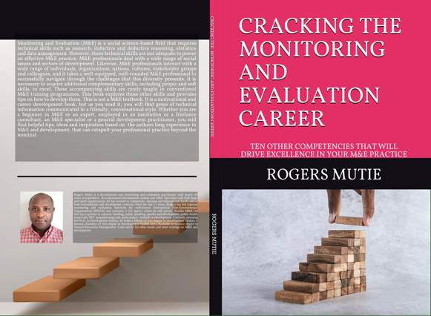
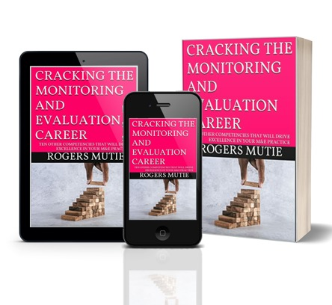
RELEVANT RESOURCE: 10 “OTHER” COMPETENCIES & HOW TO DEVELOP THEM Link: AMAZON https://www.amazon.com/dp/B099M6JHND

