Slide 1
COVID, COMPLEXITY, COUNTERFACTUALS, & CALAMITOUS CONCLUSIONS: A PROVOCATION
RAY PAWSON

Slide 2
COVID CURVES
What was the ‘shape’ of the pandemic? A, B or C? Why, in most countries, did social control policies (NPIs) met with fragile, oscillating success? The counterfactual question - without treatment and vaccination programmes (PIs) would these social suppression strategies, in the long run, have struggled to success?
A
B
C

Slide 3
The limits of the social suppression interventions are exposed in complexity theory (eight modes identified in the next slides).

Slide 4
The dynamics of complexity (1)
Disparate Command and Control Systems. The more autonomous the controlling network of hubs, the more likely that policy consistencies, contradictions, and conflicts will ensue.
Interaction and emergence. In systems that comprise of multiple intervention effects are not additive but interactive. The combination of measures may reduce, compete with, or displace the intended effect.
Policy discord and moral disharmony. Individuals who do not follow controls (free riders) still benefit from their imposition. The wayward actions of notable individuals may cause a tipping point creating a broader moral struggle between rule followers and rule breakers.
Contextual heterogeneity. The ability to avoid infection and follow controls differs widely across communities. Measures designed to reduce infection, by ignoring such contextual heterogeneity, may have the perverse effect of intensifying health inequalities.

Slide 5
The dynamics of complexity (2)
Implementation heterogeneity. Complex interventions have long implementation chains. Responsible agents often have different ambitions for the policies and different resources to execute them. Implementation heterogeneities generate outcome inconsistency.
Ambiguity in regulations and guidelines. In complex, ever-changing interventions like COVID-19, some ambiguity in these regulations is inevitable, with unclear pronouncements introducing further diversity in the public response.
Temporal change in public attitudes. Public allegiance and adherence to complex interventions varies over time. There is a typical rhythm to public commitment – moving from enthusiasm, to acceptance, to routinisation, to fatigue. The pace of change in such motivational patterns is not predictable and not under the control of policy makers.
Exit and sustainability effects. The easing of restrictions is itself a significant policy manoeuvre and carries all of the uncertainties and complexities associated with their introduction. The timing and execution of exit strategies is thus unpredictable and may generate ‘rebound effects’.

Slide 6
A Calamitous Conclusion?
It was forever asserted that UK policy was ‘led by the science’
No public policy has ever been subject to more effort, more management, more investment and more scrutiny than the social interventions to overcome the COVID pandemic.
And yet the assembled NPIs provided only a halting, intermittent solution.
Was this inevitable?
With COVID have we witnessed the limits of policy evaluation?

Slide 7
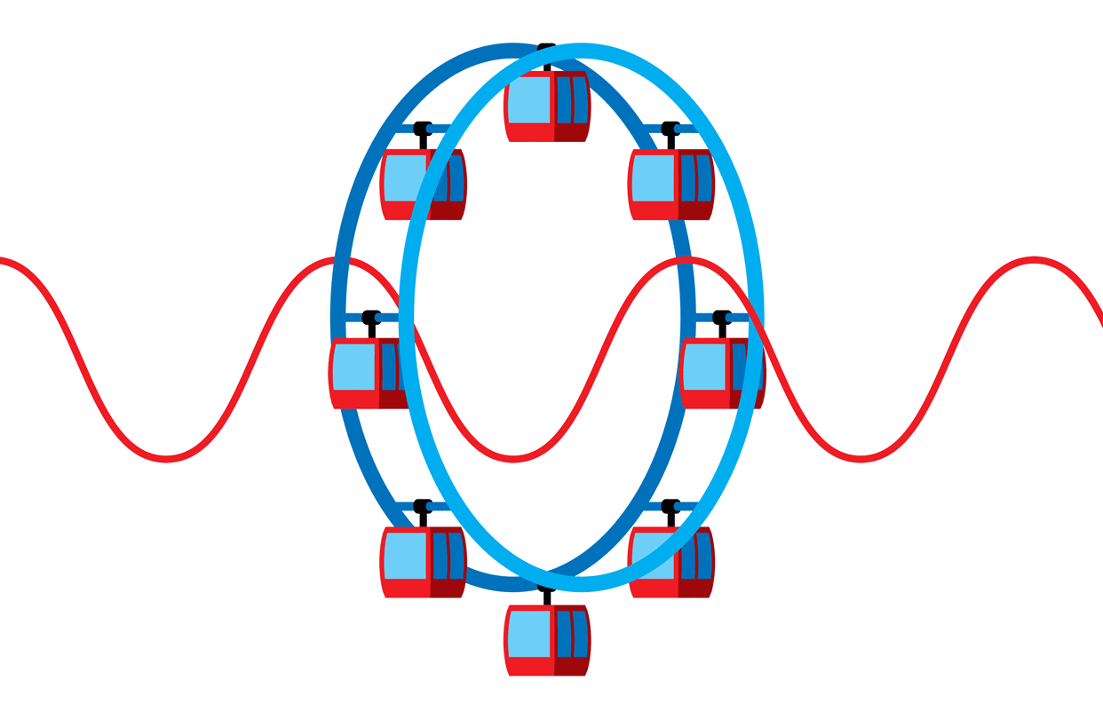
Complexity dynamics and the oscillating impact of major policy interventions. Have we seen the merry-go-round before?
The boom and bust of economic policy
The time limited impact of crime deterrents and subsequent crime waves
The trendless fluctuation of social mobility
The weak sustainability of development / aid programmes
The insoluble issue of demand management for health services
ETC.

Slide 8
For Policymakers: Remember you are designing complex, adaptive, self-transformative systems. The key task is to try to anticipate the complexity dynamics.
For Evaluators: Remember you are researching complex, adaptive, self-transformative systems. The key task is to try to trace the complexity dynamics

Slide 9
Background Reading
Pawson R. The coronavirus response: Boxed in by models. Evaluation. 2021;27(2):149-167. doi:10.1177/1356389020968579
Pawson R. (2021)The Denial of Complexity in Developing the UK COVID-19 Response. https://www.ramesesproject.org/media/WP3_-_Denial_of_complexity.pdf
Pawson R. Do Lockdowns Work? Evidence from the UK. https://realism.leeds.ac.uk/wp-content/uploads/sites/56/2021/08/Do-Lockdowns-Work-Pawson2021.pdf
Pilar Serrano-Gallardo, Ray Pawson and Ana Manzano (2021) Non-pharmaceutical interventions in COVID-19. A complexity analysis (Intervenciones no farmaceúticas en la COVID-19. Un análisis desde la complejidad) Gaceta Sanitaria (under review)

