Slide 1
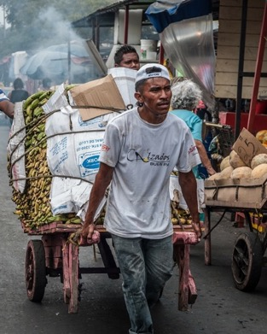
Planning and Exiting for Sustainability…
Evaluation Center for Complex Health, Univ. Toronto
Jindra Cekan PhD, Valuing Voices, March 2021

Slide 2
1. Assumptions must be tested during project & ex-post
Global Development Aid Industry widely assumes its work is sustainable. Yet Valuing Voices research has found that less than 1% of all USAID and EU projects have been evaluated ex-post for actual sustainability…
Donors exit countries and projects often based on national
statistics, with scant data on the sustainability of their own projects before or after exit
“Sustainability plans cannot be based on the hope that activities and benefits will continue in the absence of [proof]…”
(Rogers, Tufts)
Currently there is little adaptation of timeframes or phasing over or down. Mostly donors exit out after funding has been used.
This needs to change to foster sustained exit
Sources See: Source: Valuing Voices Research for Michael Scriven’s foundation (2017) http://valuingvoices.com/building-the-evidence-base-for-post-project-evaluation-a-report-to-the-faster-forward-fund & Rogers, B. L., & Coates, J. https://www.fantaproject.org/research/exit-strategies-ffp

Slide 3
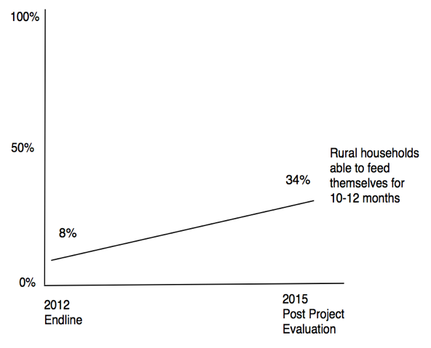
Mostly Positive: Great Food Consumption Impact… but unsustained incentives
Participating households reported an increase in the number of months of food self- sufficiency post-project by 30%.
But health programming decreased, especially breastfeeding and food-aid incentivized activities stopped
USAID/ CRS Niger, Nutritional and Food Security Program (PROSAN Rayuma)
See ex-posts: https://valuingvoices.com/catalysts-2/

Slide 4
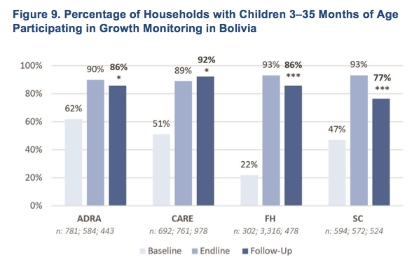
Mixed Results: Child Growth Monitoring Outcomes
Decreased growth monitoring from end line by only 4-16% (ADRA, FH, SC)
Improved growth monitoring by 3% (CARE)
ADRA, CARE, FH, Save the Children Bolivia
USAID Exit Strategies, 4-country study, Tufts
Friedman School of Nutrition and FHI/360 ’16
See ex-posts: https://valuingvoices.com/catalysts-2/

Slide 5
Mixed Results with Unexpected Positive Results in Village Savings and Empowerment… but Could have Good News Unevaluated
Only 2/3 banks were sustained…
But 10% were new village banks formed post-closure in communities by word of mouth or self-help training
No baseline or final, only since midterm
PACT WORTH Nepal 2008
See ex-posts: https://valuingvoices.com/catalysts-2/

Slide 6
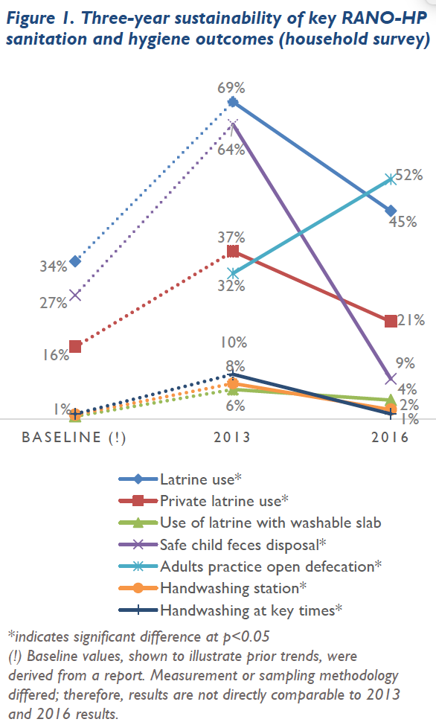
Worst Case: Negative Water/ Sanitation Outcomes:
Less than stellar results at endline
Dismal rates of feces disposal (below baseline), handwashing (below midterm). Nearly doubled open defecation (from midterm)
Discouraging rates of Latrine use (decreases by 60-75%)
Baseline only re-created
USAID/ CRS/ CARE/ CARITAS, and local NGOs Madagascar, RANO-HP project
See ex-posts: https://valuingvoices.com/catalysts-2/

Slide 7
What is the role for measurement, learning, and evaluation approaches in planning exit strategies for interventions?
Seeing ourselves as “the Other”
https://www.euronews.com/living/2020/05/13/

Slide 8
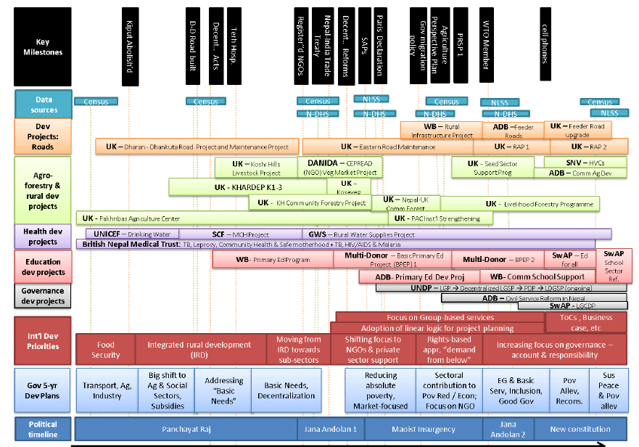
THIS is NOT SUSTAINABILITY.
Design/ Fund for Locally-driven Sustainability, Test Assumptions, Exit over 1 year+ for Sustainability
From Patricia Rogers, joint AEA “Barking up a Better Tree” presentation 2016. Ausaid Stronger Families and Communities Strategy 2000-2004:
Australian federal government funding program supporting 635 short-term projects, with different starting and finishing dates

Slide 9
1. Assumptions must be tested during project & ex-post
Global Development Aid Industry widely assumes its work is sustainable. Yet Valuing Voices research has found that less than 1% of all USAID and EU projects have been evaluated ex-post for actual sustainability…
Donors exit countries and projects often based on national
statistics, with scant data on the sustainability of their own projects before or after exit
“Sustainability plans cannot be based on the hope that activities and benefits will continue in the absence of [proof]…”
(Rogers, Tufts)
Currently there is little adaptation of timeframes or phasing over or down. Mostly donors exit out after funding has been used.
This needs to change to foster sustained exit
Sources See: Source: Valuing Voices Research for Michael Scriven’s foundation (2017) http://valuingvoices.com/building-the-evidence-base-for-post-project-evaluation-a-report-to-the-faster-forward-fund & Rogers, B. L., & Coates, J. https://www.fantaproject.org/research/exit-strategies-ffp

Slide 10
Exit Strategies Process: Phasing Down, Over and Out Throughout
1. PHASING DOWN
Funder/(I)NGO2 reduces activity level/financing level of some or all activities over time which enables partners to build ownership and capacities to sustain some activities. Partners get support for new resources or capacities via new partnerships
It includes support to project, learning from M&E by stakeholders with benchmarks plus feedback/ communication preparing for exit
It may include adapting activities or changing timeframe
2. PHASING OVER
Funder/(I)NGO progressively hands over during implementation to gauge uptake by successor(s). Successor institution identified that will continue providing activity or service or an adapted version, with existing project assisting a successor institution in securing needed resources, partnerships, capacities, and ownership plus transferring data, benchmarks of readiness to exit
3. PHASING OUT
Donor/ (I)NGO discontinues support and involvement on fixed timeframe with no new sponsor is identified (or possibly needed) for the activity
If fixed exit, evaluate and consider triage of unsustainable activities to foster sustainability of the rest along the project cycle early on
Revised from CSAFE 2005: https://reliefweb.int/sites/reliefweb.int/files/resources/A02C7B78FB2B408B852570AB006EC7BA-What%20We%20Know%20About%20Exit%20Strategies%20-%20Sept%202005.pdf Revised from Rogers/ Macias FANTA 2004
Also see INTRAC Timeline approach: https://www.intrac.org/wpcms/wp-content/uploads/2016/09/INTRAC-Praxis-Paper-31_Developing-a-timeline-for-exit-strategies.-Sarah-Lewis.pdfhttps://www.intrac.org/wpcms/wp-content/uploads/2016/09/INTRAC-Praxis-Paper-31_Developing-a-timeline-for-exit-strategies.-Sarah-Lewis.pdf

Slide 11
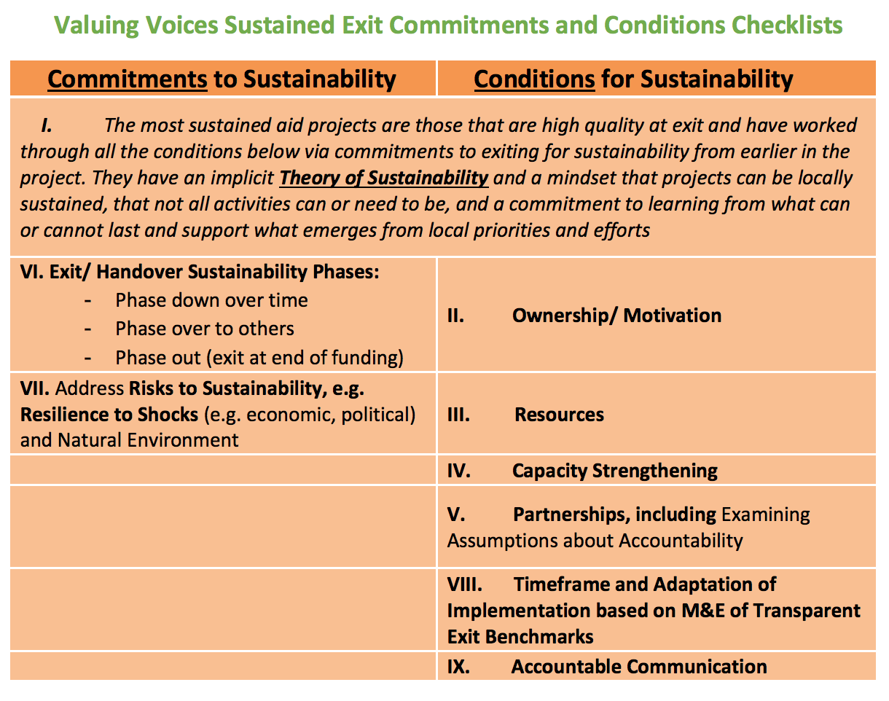
Also see: https://aea365.org/blog/ex-post-eval-week-exiting-for-sustainability-by-jindra-cekan-2/ & https://valuingvoices.com/wp-content/uploads/2020/12/Exit-For-Sustainability-Checklists-12.2020-updated.pdf

Slide 12
Plan, Implement, Evaluate for Sustained Exit

Slide 13
Expenditures: $3.5 trillion spent on foreign aid since 1950
$137 billion was spent in 2014 alone on development projects
We must maximize collaborative eval, focused on what locals can sustain. Without Valuing their Voices, strengthening their ownership, existing capacities, partnerships, resources, we will fail them & ourselves.

