Slide 1
Leaving No One Behind !
Why is it a Spectacular Ambition?
OR
What is the ‘BIG DEAL’ ?
Abhijit Das

Slide 2
The Evaluators’ Conundrum…….
Lofty Goals and Modest Achievements
Grand Aspirations
Human Rights for All
Health For All by 2000 , Education for All 2015…….
Rights based Development
Rio Conference, Vienna Conference, Cairo Conference, Beijing Conference…….
Development with focus on the Poor
Millennium Development Goals (MDGs – 5 Goals)
Sustainable Development for All ( Include the Non-Poor BUT Leave No One Behind)
Sustainable Development Goals ( 17 Goals – Numerous Indicators)
HOW TO MAKE THIS WORK

Slide 3
Why are ‘slow’ progress and ‘modest’ achievements NOT ENOUGH ?
Who gains more ?
Who gains less ?
Who doesn’t gain ?
ARE THERE ANY LOSERS ?

Slide 4
Foundational Experiences
The Story of Rani Jaiswal
The story Behind the
Indicators
The Case of ‘Typhoid Pneumonia’
Understanding
Context

Slide 5
‘Development’ Changes Relationships !
Between Poor and the non- Poor
Women and Men
The ‘minorities’ and the ‘Majority’
Community and its Traditional Leaders
The Service Provider and the Service Seekers
The Beholden and to Whom they are Beholden in
Very Diverse and Hierarchical Societies
It is all about
POWER
Understanding the Limits to Benevolence and Pushback

Slide 6
A Common Programme Approach
People Have a Whole Range of ‘Undesirable’ Behaviours
THEY……
Marry their daughters too early
Have too many children
Don’t use contraceptives
Don’t go to hospital for medical care, go to traditional / informal providers
Don’t practice hygiene – handwashing, open defecation
Don’t take medicines as prescribed
etc…..
HOW TO CHANGE PEOPLE TO FIT INTO OUR ‘MODEL BEHAVIOUR’ ?

Slide 7
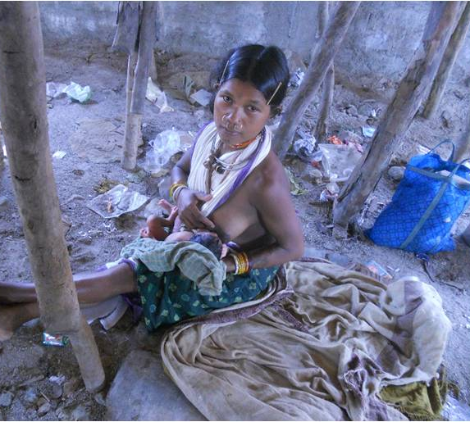
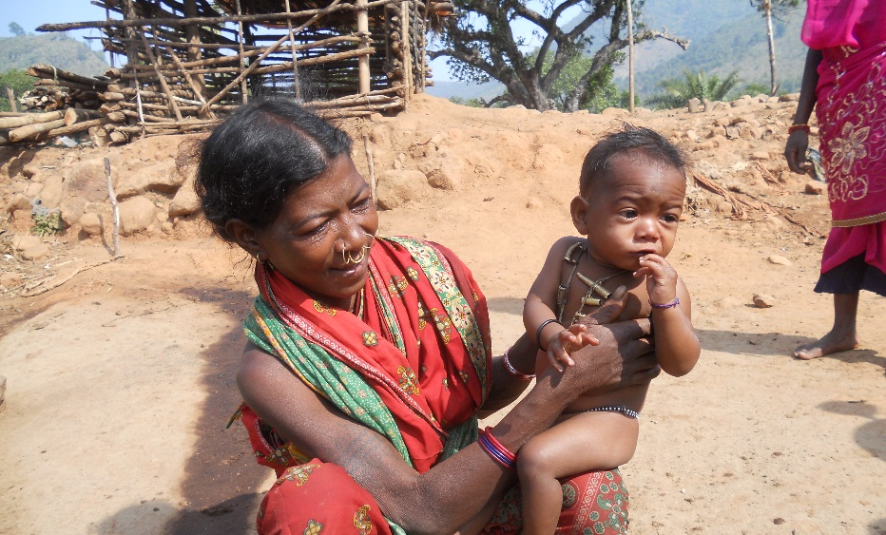
Reality of the Lives of the Most Marginalised ( Kalyansinghpur Bl. Raygada District, Odisha)
Will the same range of services work for all?
Institutional delivery
Skilled Attendant
Referral Transport
Emergency Obstetric Care
How? Why?
Notes:
This study was conducted in Kalyansinghpur block of the mineral rich and densely forested district of Rayagada in southern Odisha, where STs comprise 56% of the population. Study was conducted among plains Kondhs – forest dwelling, don’t speak Odiya, very low literacy, separate culture and health belief systems

Slide 8
Understanding Lived Realities
Understanding People and Communities - What is their self concept or self determination? What are their ‘Aspirations’ What are their ‘Compulsions’?
State – Citizen relationships - What kinds of legal protections are available – ‘de facto’ and ‘de jure’? What kinds of accountability mechanisms exist?
Is Marginalisation (economic/geographic) and Social Exclusion (stigma/ discrimination) the same ?
How much diversity of lived health related experiences have we really understood ? ( data sources/ interpretation/world views)
Do we understand Community concerns and consequences?
Desired Behavior
Model Behaviour
Deviant Behaviour
Stigma/
Coercion

Slide 9
Consequences of Poor Services
Who pays the Cost?
Who are accountable?

Slide 10
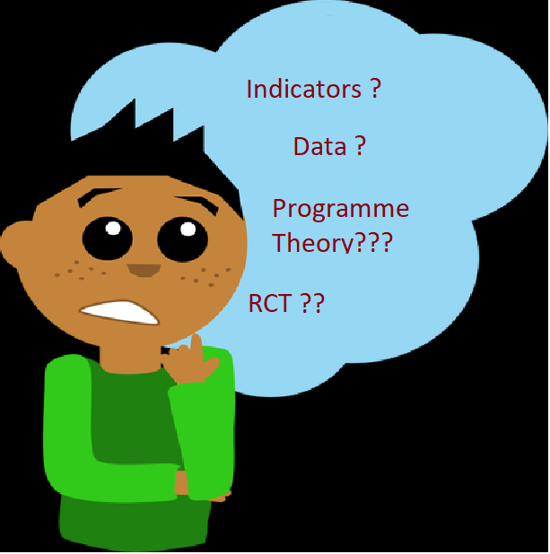
The Ethical Conundrum………..
Outcomes?
Who do we Evaluators ‘serve’ ?
Donors
International Agencies
Country Governments
Programme Impementors
Vested Interest Groups in the Community
Those who often get ‘Left Behind’

Slide 11
Thank You

